Slide 1

Whose Slide Is
It Anyway?

Slide 2

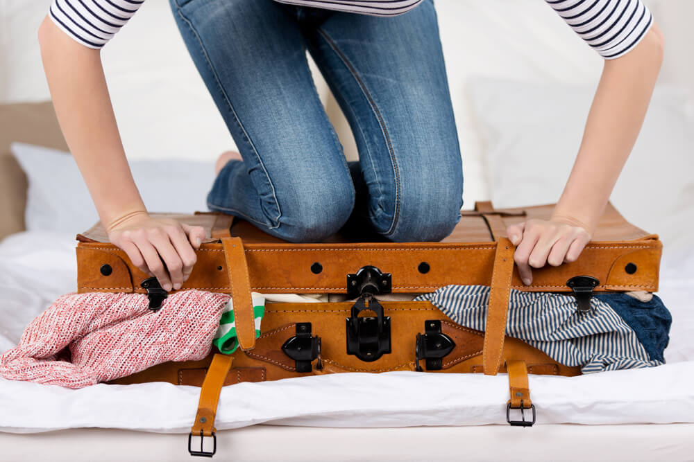
Finally, the long awaited day of departure came...

Slide 3
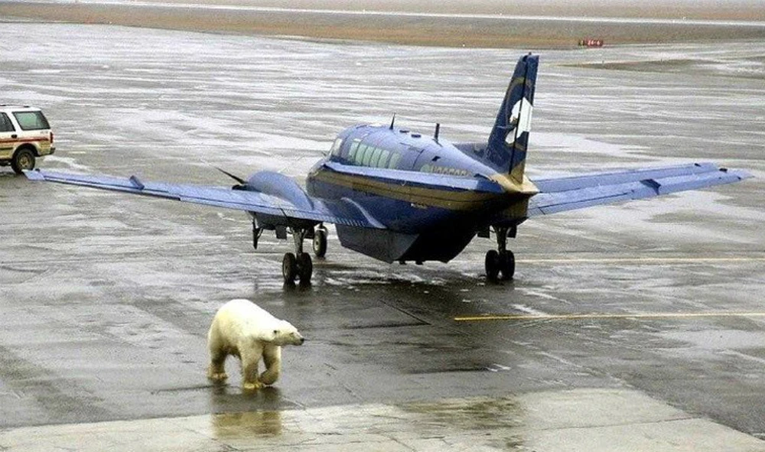
When we landed, the ground crew was nowhere to be found.

Slide 4
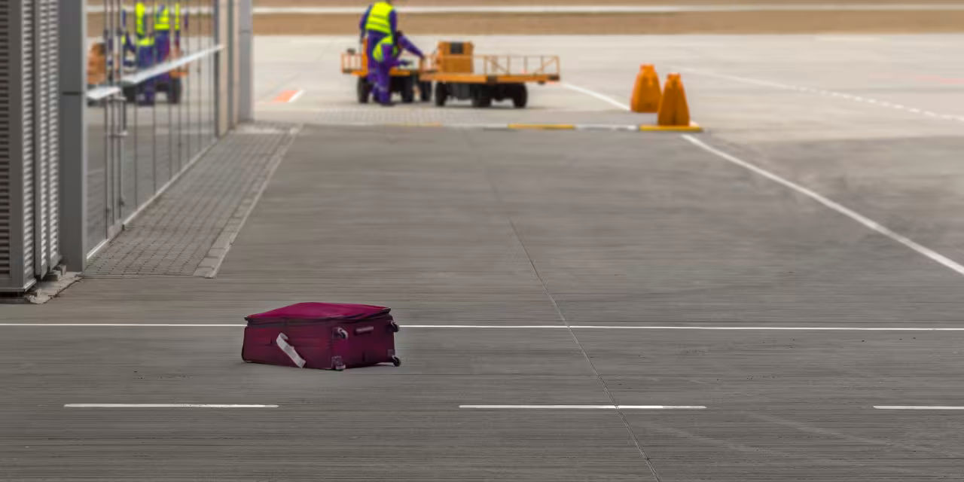
Unbeknown to me, however, there was one small hitch.

Slide 5
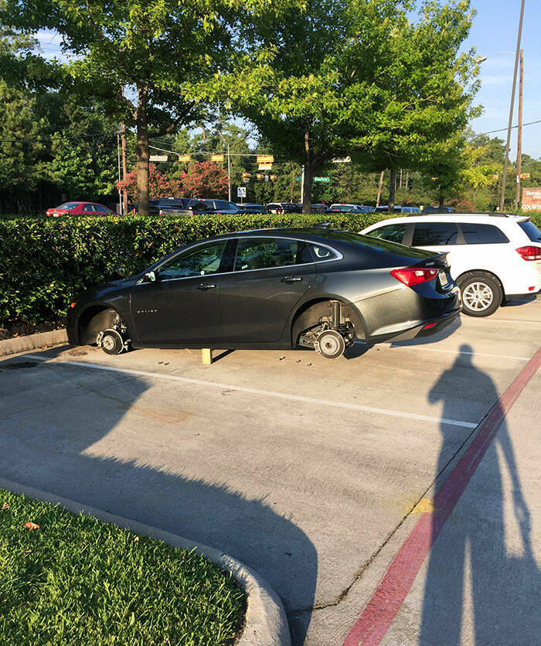
Apparently, the rental company charged extra for wheels.

Slide 6
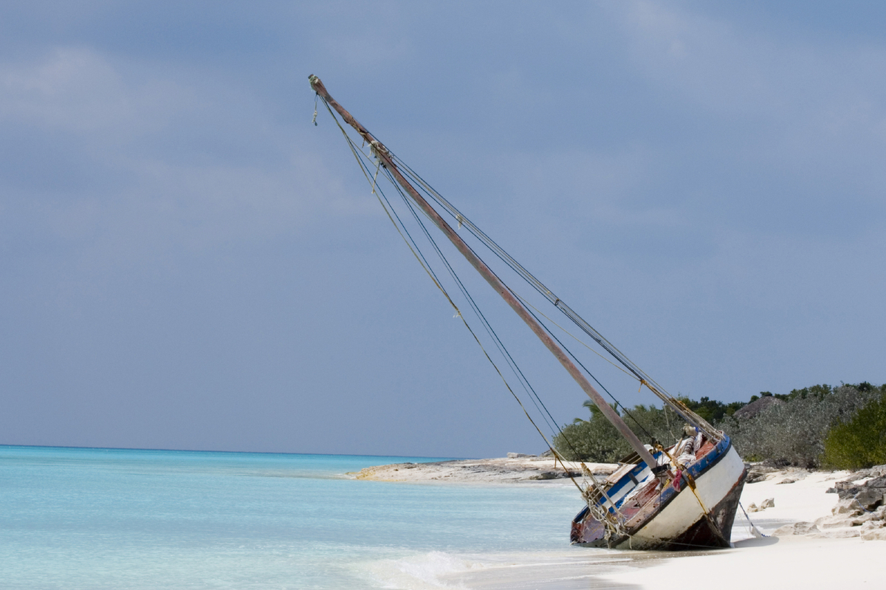
Having no luck with the car rental, I tried to find a ferry.

Slide 7
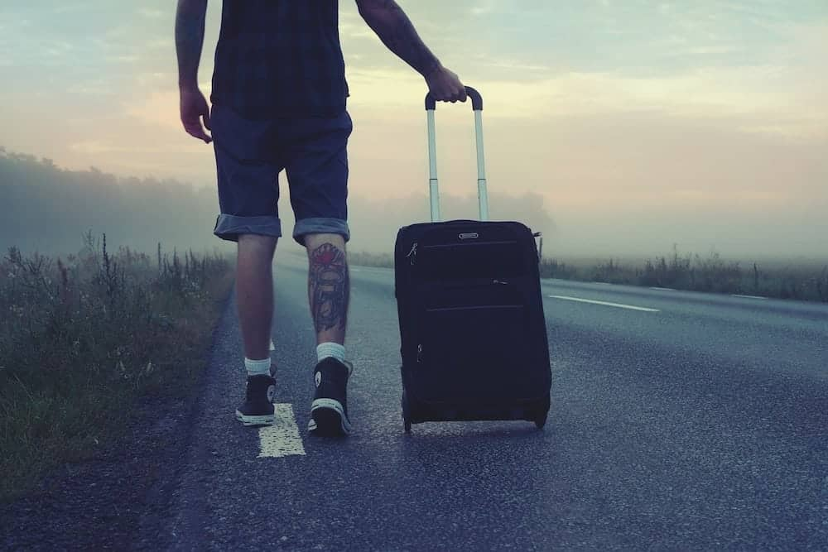
Without a vehicle, I decided to set off on my own.

Slide 8
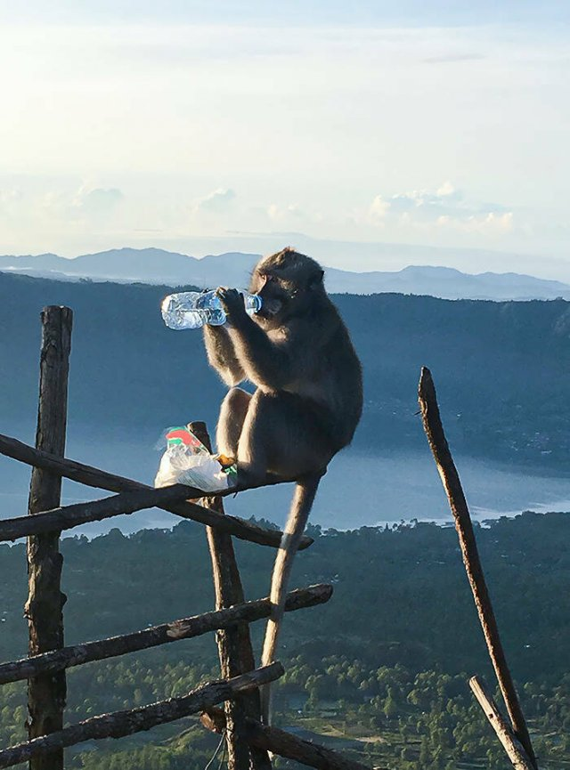
This little guy hopped over, stole the last of our food and water
and then calmly ate it in front of us.

Slide 9
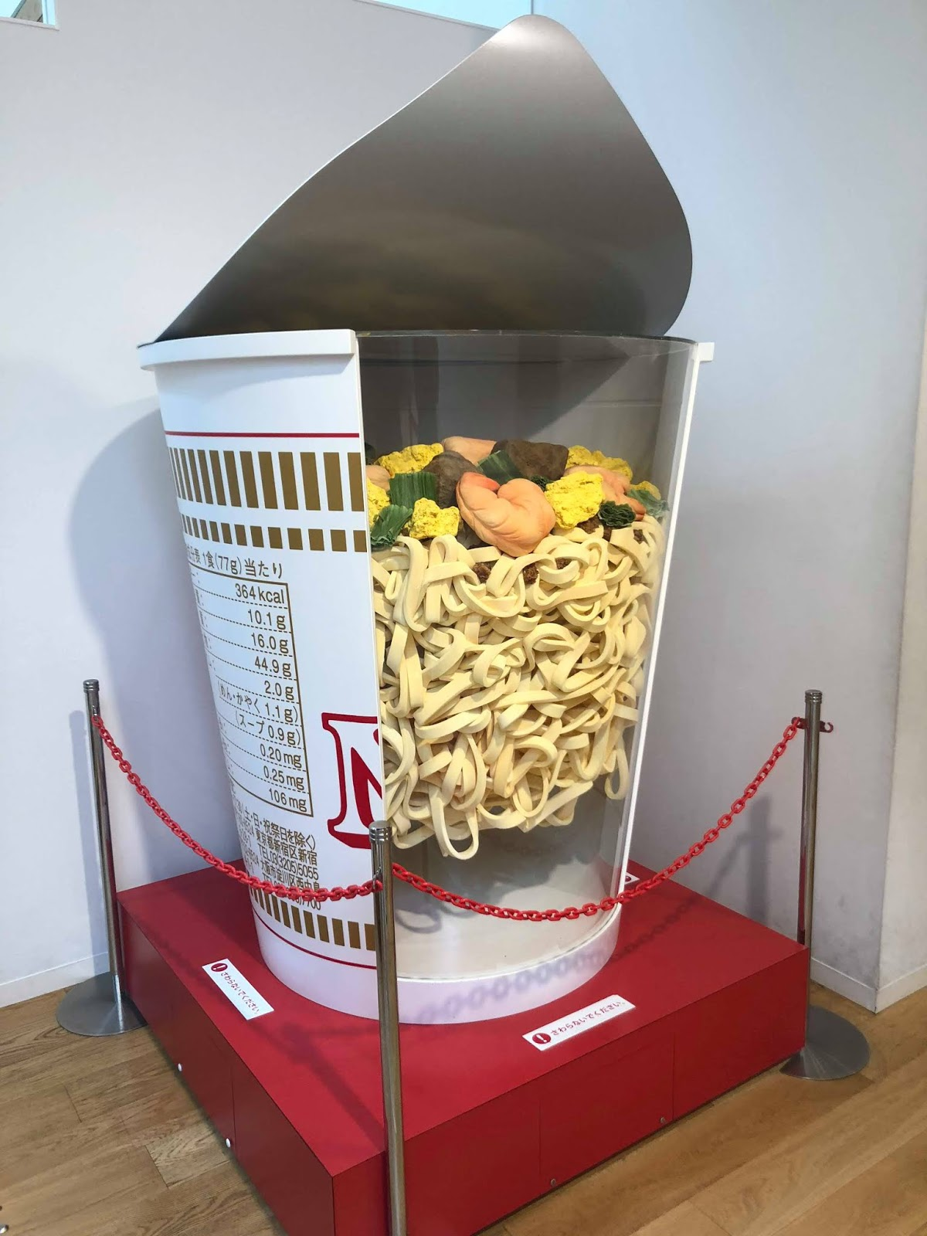
We were so hungry but all of the food was roped off!

Slide 10
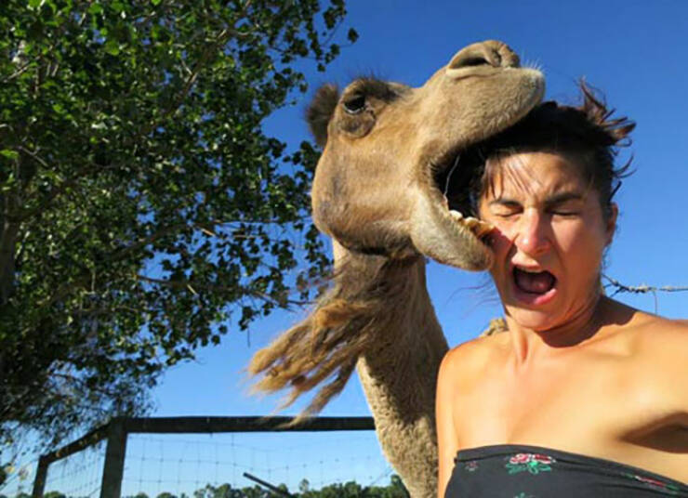
And then a camel tried to steal my girlfriend.

Slide 11
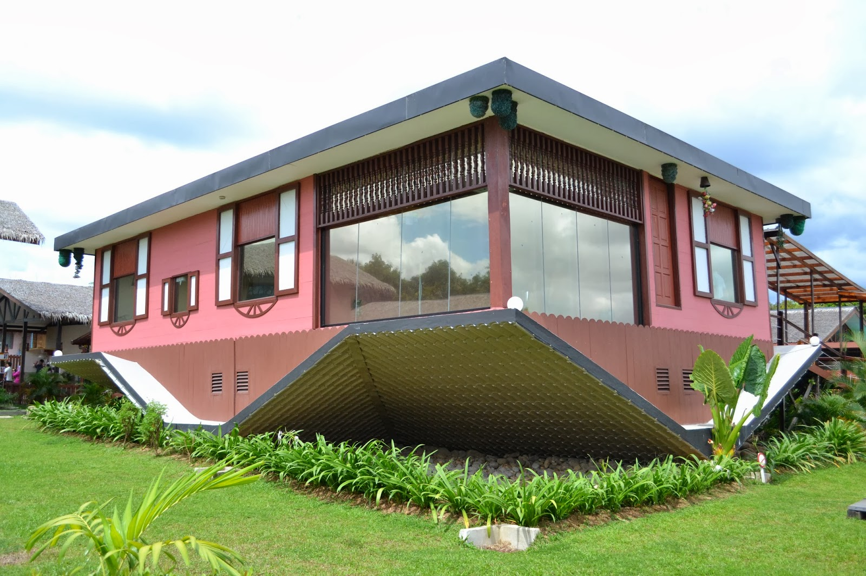
I really just wanted to sleep in my own bed, but when we got home, another surprise was waiting for us...

